Slide 1




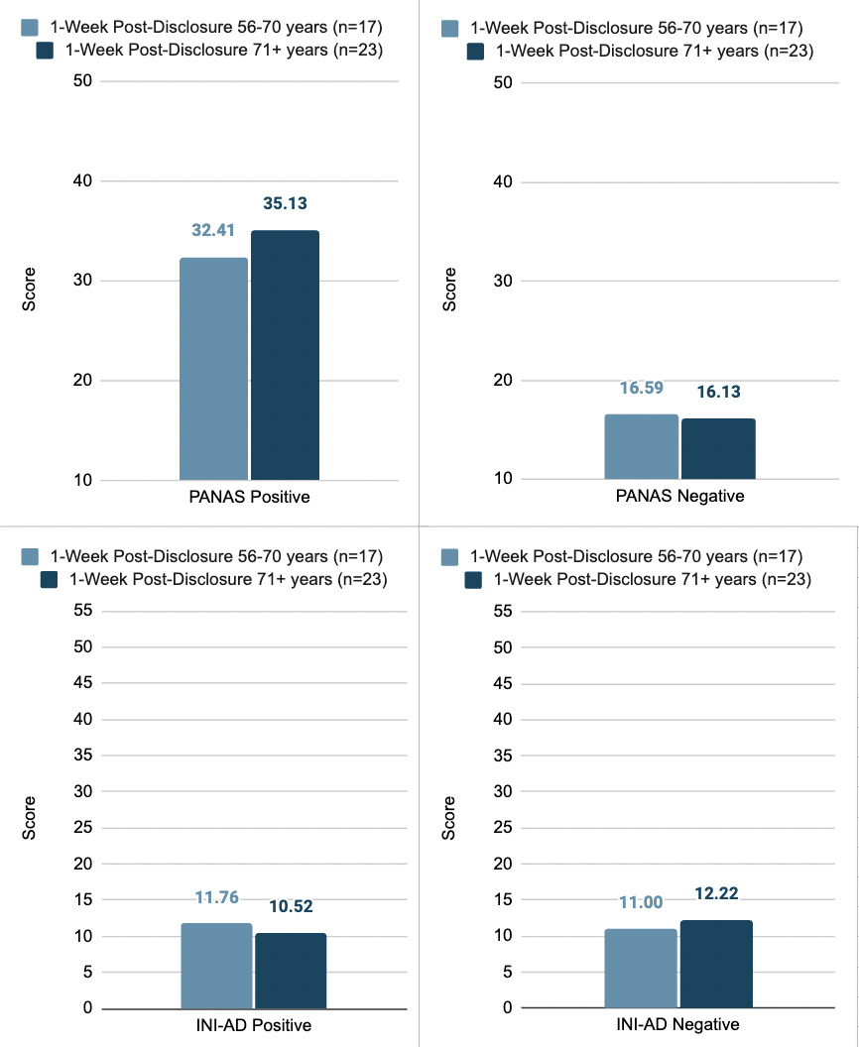
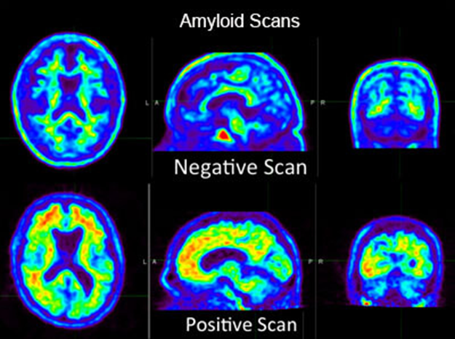
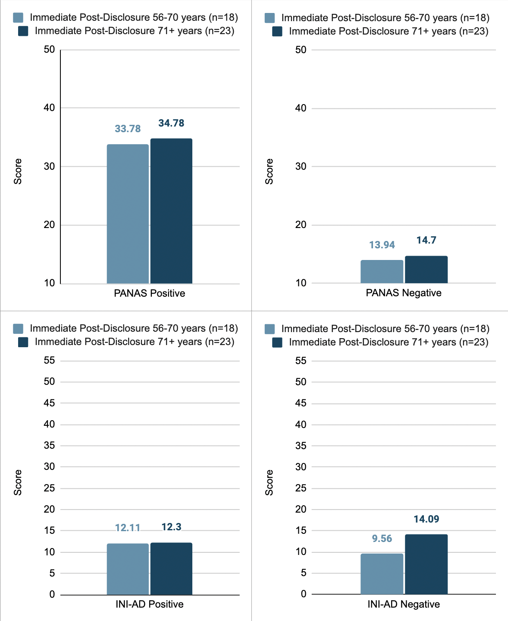

Age Effects on Emotional Reactions Following
Alzheimer’s Disease Biomarker Disclosure
Kayla Drifka, Annalise Rahman-Filipiak, Haley Kohl, Gloria Whitaker
University of Michigan, Michigan Medicine, Department of Psychiatry
Abstract
Methods
1 Week Post-Disclosure
Alzheimer's disease (AD), the primary cause of dementia, involves abnormal amyloid and tau protein accumulation detectable through positron emission tomography (PET) scans. Elevated amyloid indicates AD brain changes, while both amyloid and tau confirm diagnosis. Research suggests minimal mood or anxiety disorder changes post-biomarker disclosure; however, factors predicting emotional responses, including age, remain understudied. This study aims to investigate emotional reactions after learning positive PET amyloid biomarker status among 49 participants 55 years of age and older with Mild Cognitive Impairment (MCI) or Dementia Alzheimer’s Type (DAT) ​​as a function of age. Emotional reactions were assessed using the Positive and Negative Affect Scale - Short Form (PANAS-SF) and and Impact of Neuroimaging in Alzheimer's Disease (INI-AD). We compare reactions between two age groups (55-70 and 71+), hypothesizing a more negative affect in the younger group. Overall, there were non-significant effects of age for both measures. Despite this, these findings emphasize the importance of further research replication with larger sample sizes and diverse study populations. Understanding reactions and disclosure age contributes to broader biomarker impact understanding.
Participants had previously completed an amyloid (PiB) PET
An elevated (positive) scan was defined as 20 centiloids or higher.
Disclosure Session: Led by trained study team clinician, session included participant and loved ones, sharing PET scan results, meaning, and relevant resources.
Immediately following disclosure and at 1- and 6-week follow-up, participants completed brief measures of psychological reactions to disclosure.
Analysis focused on data immediately following and at 1-week post-disclosure.
Table 2. Group differences by measure at 1-week post-disclosure.
Overall Result: No significant differences in psychological reactions by age.
Figure 2. Average Psychological Outcomes by Age 1 Week Following Disclosure
 | 1-Week Post-Disclosure
 | F₁ | p | η_{p}²
PANAS Positive | 0.992 | 0.325 | 0.025
PANAS Negative | 0.039 | 0.845 | 0.001
INI-AD Positive | 0.798 | 0.377 | 0.021
INI-AD Distress | 0.125 | 0.736 | 0.003
Overall Result | F4,35 = 1.050 | 0.396 | 0.107
Measures
Positive and Negative Affect Scale Short Form (PANAS-SF^{)2:}
Measures positive and negative affect using a 20-item subscale on a 5-point Likert-style scale
Range 10-50
Impact of Neuroimaging in Alzheimer's Disease (INI-AD^{)3:}
Measures reactions related to receiving AD-specific neuroimaging results
distress (range 0-55)
positive emotions (range 0-20)
Background
Table 1. Group differences by measure immediately following disclosure.
Overall Result: No significant differences in psychological reactions by age.
Figure 1. Average Psychological Outcomes by Age Immediately Following Disclosure
Understanding emotional reactions to biomarker disclosure is crucial for ensuring patient well-being, safeguarding against potential adverse emotional responses, and recognizing the diversity of emotional responses in Alzheimer's disease patients.
Examining the role of participant age at the time of disclosure can provide insights into predicting emotional reactions to positive PET amyloid biomarker status.
Hypothesis: participants within the ages of 55-70 will display a more negative affect than their older counterparts of 71+.
Results
Immediate Post-Disclosure
 | Immediate Post-Disclosure
 | F₁ | p | η_{p}²
PANAS Positive | 0.205 | 0.653 | 0.005
PANAS Negative | 0.222 | 0.640 | 0.006
INI-AD Positive | 0.029 | 0.866 | 0.001
INI-AD Distress | 2.341 | 0.134 | 0.057
Overall Result | F4,36 = 0.622 | 0.650 | 0.065
Conclusions
Contrary to our hypothesis, younger participants did not exhibit higher distress levels post-disclosure.
Overall, there were no significant differences in psychological outcomes among participants by age, aligning with previous research⁴.
The medium effect size difference in both measures and time points by age suggests that our small sample size may have limited our ability to detect differences. This study is ongoing and recruitment will continue into 2024.
Limitations: small sample size may limit generalizability of findings.
Future studies should replicate findings with larger and more diverse samples.
Methods
Participants
References
Erickson CM, Clark LR, Ketchum FB, Chin NA, Gleason CE, Largent EA. Implications of preclinical Alzheimer's disease biomarker disclosure for US policy and society. Alzheimer's Dement. 2022; 14:e12339. https://doi.org/10.1002/dad2.12339
Watson, D., Clark, L. A., & Tellegen, A. (1988). Development and validation of brief measures of positive and negative affect: the PANAS scales.Journal of personality and social psychology,54(6), 1063
Chung, W. W., Chen, C. A., Cupples, L. A., Roberts, J. S., Hiraki, S. C., Nair, A. K., Green, R. C., & Stern, R. A. (2009). A new scale measuring psychologic impact of genetic susceptibility testing for Alzheimer disease. Alzheimer disease and associated disorders, 23(1), 50–56. https://doiorg.proxy.lib.umich.edu/10.1097/wad.0b013e318188429e
Masters, M. C., & Morris, J. C. (2015). Abstract thinking and memory in aging: The relationship with education. Alzheimer's & Dementia, 11(4), 370-377. https://doi.org/10.1016/j.jalz.2015.09.005
Participants were recruited from an ongoing neuromodulation clinical trial aged 55+ years with Amnestic Mild Cognitive Impairment (MCI; n=33) or Dementia Alzheimer’s Type (DAT; n=32)
We selected only amyloid elevated participants (n=49)
Excluded participants with moderate or severe depression or anxiety, or significant neurological conditions.
Created two age strata: 55 to 70 years and 71 years and above.
Sex | 53.1% Female
Race | 95.9% White
Age | 71.06 ± 6.88 years
Education | 16.16 ± 2.37 years
This study was funded by R01AG058724 (PI: Hampstead), R35AG072262 (PI: Hampstead) & 1K23AG07004401-A1 (PI: RahmanFilipiak) from the National Institute on Aging
The RP-CNBI would like to thank our participants and their families for their time and trust in volunteering for this study.

